Slide 1
FitBet
A social workout platform

Slide 2
Problem
Looking for fitness motivation
Like social interaction with friends
Existing fitness apps require same device
Existing fitness challenges are not personal

Slide 3
Solution - Fitbet
Multi-device
Personal
Social platform
group interaction
Chat interface
Challenges
Bet (venmo), custom

Slide 4
Technology integrations
Step data
User Interface
Authentication
User & Challenge data

Slide 5
MVP Data Flow
Profile settings (passport variable)
Login page
challenge table
Challenge details
Registration page
User table
Search and join
challenges
User table
Ext device APIs
Ext device APIs
User table

Slide 6
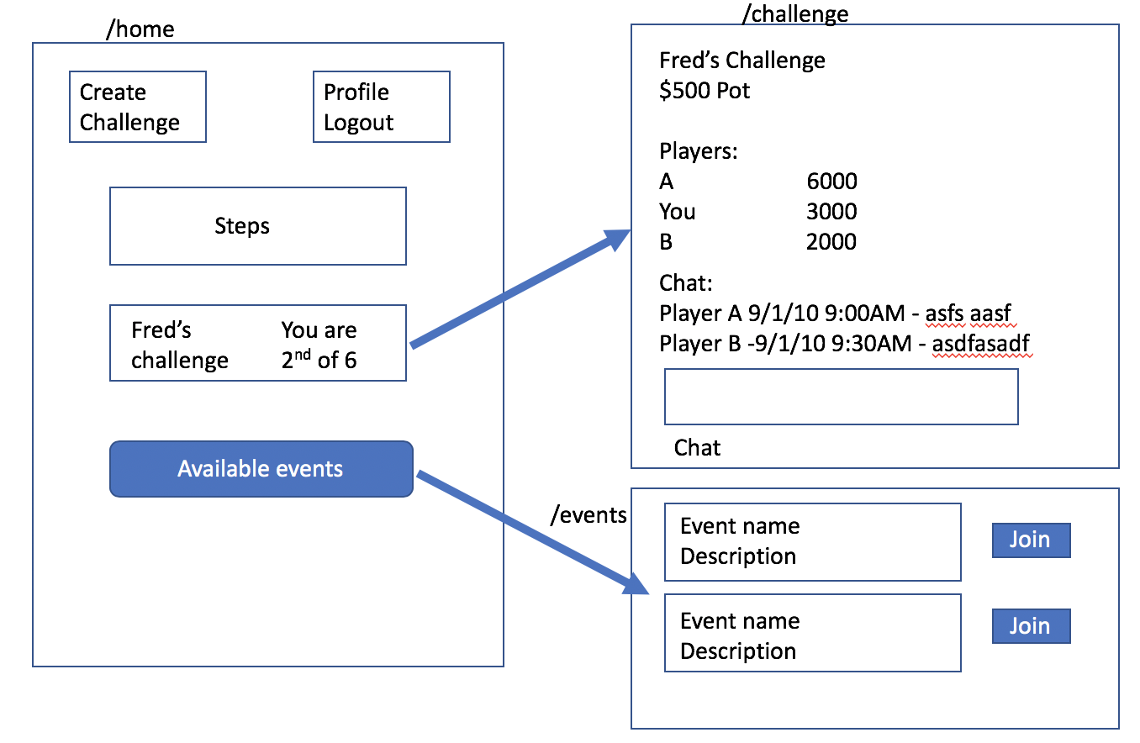

Slide 7
